Slide 1


EEC1361 – SOLAR ENERGY TECHNOLOGY SOLAR-POWERED AUTONOMOUS IOT WASTE SEGREGATION AND RECYCLING SYSTEM WITH MACHINE LEARNING ON ESP8266 BATCH NO : 2
PRESENTED BY:
KARUNYA SHREE S [927623BEE042]
MADHUMITHA P [927623BEE051]
NISHANTHINI S [927623BEE062]
GUIDED BY:
Mrs.P.SASIREKHA m.e.,
Assisstant professor

Slide 2
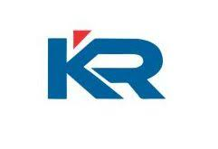
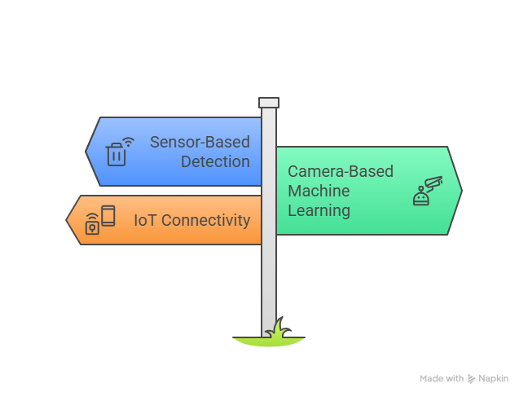
ABSTRACT
This project presents a solar powered autonomous IoT waste segregation and recycling system using ESP8266 and machine learning to enable efficient and sustainable waste management.
The system operates entirely on solar energy and automatically identifies and segregates waste using multiple sensors and a camera-based CNN model.
Sensors detect wet, metal, organic and other wastes while machine learning accurately classifies electronic waste. An automated conveyor and bin mechanism ensures proper sorting with minimal human intervention.
IoT connectivity enables real-time monitoring and bin-full alerts. The proposed system improves segregation accuracy, reduces health risks, supports recycling, and is suitable for smart cities, institutions, and remote areas.

Slide 3
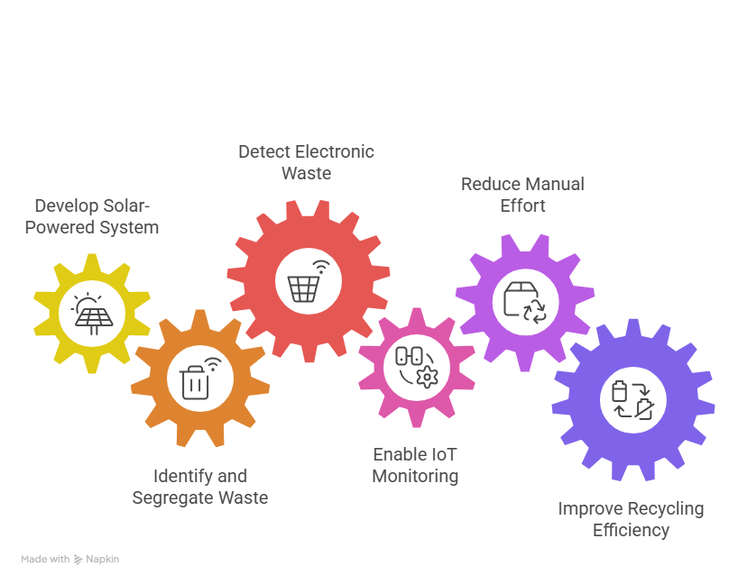
OBJECTIVES
To develop a solar-powered automated waste segregation system.
To identify and segregate waste using sensors and machine learning with 90–93% accuracy.
To accurately detect electronic waste using a CNN-based model.
To enable IoT-based monitoring and bin alerts using ESP8266.
To reduce manual effort and improve recycling efficiency.

Slide 4
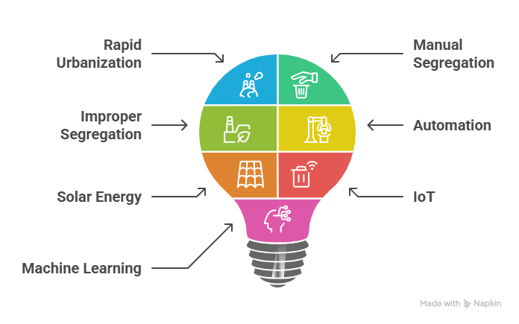
INTRODUCTION
Rapid urbanization has increased the volume of waste.
Manual waste segregation is inefficient and poses health risks.
Improper segregation reduces recycling efficiency and harms
the environment.
Automation helps improve accuracy and speed of waste separation.
Solar energy ensures eco-friendly and uninterrupted operation.
IoT enables real-time monitoring and smart waste management.
Machine learning improves accurate identification of electronic waste.

Slide 5
literature REVIEW
S.NO | TITLE OF PAPER | YEAR OF PUBLICATION | AUTHORS | DESCRIPTION | PROBLEM IDENTIFIED
1. | IoT-Based Smart Waste Management System | 2022 | Kumar, R., & Singh, P. | Reviews IoT technologies used for smart waste collection, monitoring, and management. | Lack of automation, inefficient waste monitoring, and delayed waste collection.
2. | Machine Learning Techniques for Automated Waste Classification | 2021 | Sharma, A., & Verma, S. | Discusses machine learning methods for automatic waste classification. | Low accuracy in traditional sensor-based waste segregation systems.
3. | Solar-Powered Smart Waste Segregation Using Microcontroller and Sensors | 2020 | Patel, D., & Joshi, M. | Presents a solar-powered waste segregation system using sensors and microcontrollers. | Limited intelligence, no ML integration, and reduced segregation accuracy.

Slide 6
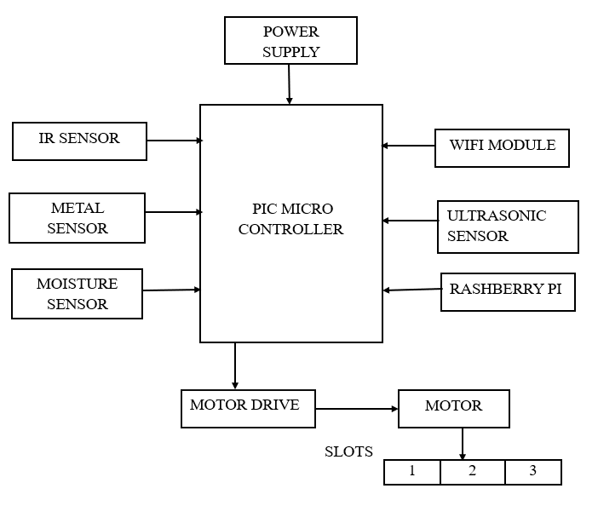
Existing SYSTEM
TITLE: IoT-Based Smart Waste Management System Using Sensors and Microcontrollers (R. Kumar and S. Sharma)
Uses a PIC microcontroller for control.
IR, metal, moisture, and ultrasonic sensors detect waste.
Waste is sorted using basic logic.
Motor and slots are used for segregation.
Wi-Fi and Raspberry Pi provide limited monitoring.
Low accuracy and no machine learning support.

Slide 7
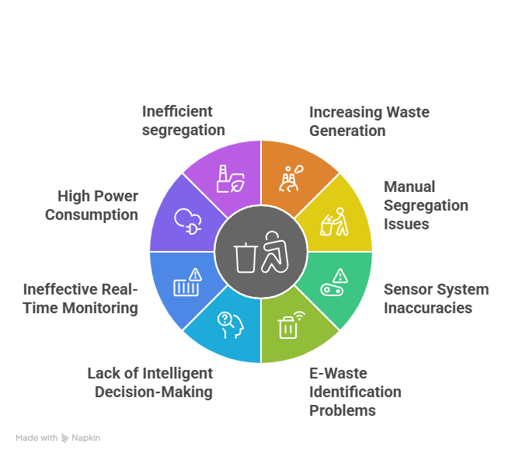
PROBLEM IDENTIFICATION
Increasing waste generation due to urbanization and population growth.
Manual waste segregation is time-consuming and unsafe.
Existing sensor-based systems have low accuracy in waste classification.
Electronic waste cannot be identified reliably using basic sensors.
Lack of intelligent decision-making (no machine learning support).
No effective real-time monitoring or timely bin-full alerts.
High power consumption and dependence on conventional electricity.
Inefficient segregation leads to poor recycling and environmental pollution.

Slide 8
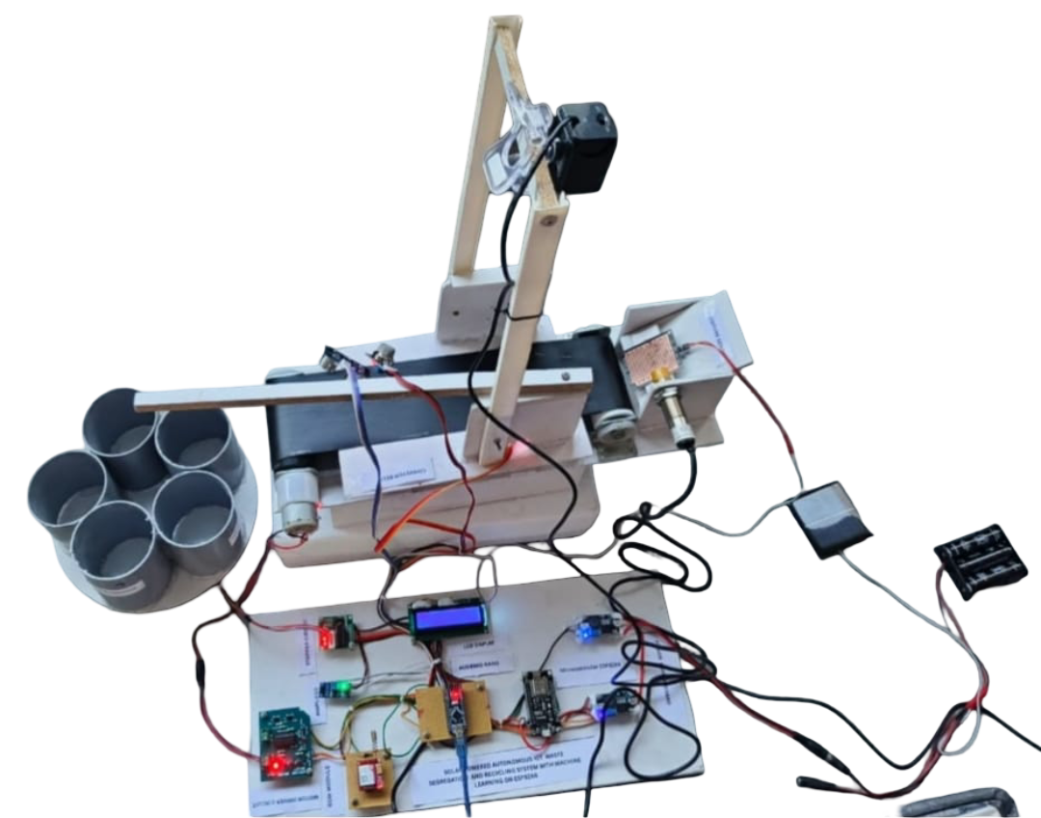
proposed SYSTEM
Solar-powered automatic waste segregation system.
Uses ESP8266 (IoT) for control and monitoring.
Sensors detect different types of waste.
Camera with CNN identifies electronic waste.
Arduino Nano controls sensors and motors.
Conveyor and bins separate waste automatically.
LCD shows system status.
GSM/Wi-Fi send alerts.
90–93% accurate and reduces human effort.

Slide 9
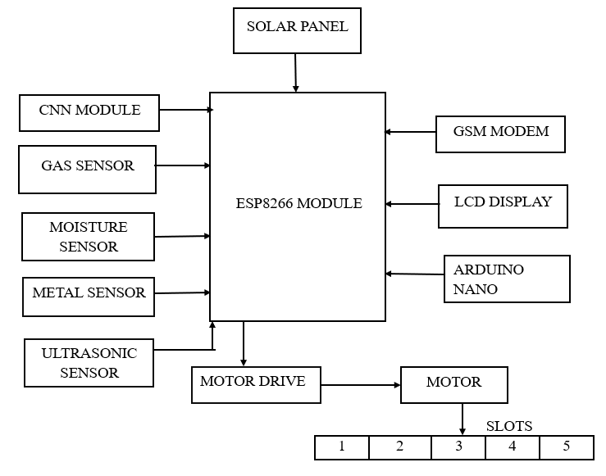
Block diagram

Slide 10
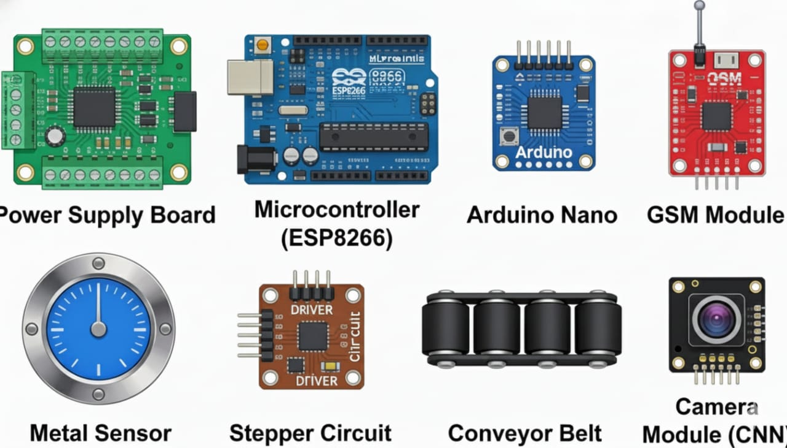
Components details
Power Supply Board: Provides stable power from the solar panel to all components.
Microcontroller (ESP8266): Main control unit handling sensors, IoT, and processing.
Arduino Nano: Supports additional sensor or motor control tasks.
GSM Module: Sends SMS alerts when bins are full.
Metal Sensor: Detects metallic waste items.
Stepper Circuit: Controls motor movement for waste direction.
Conveyor Belt: Moves waste for detection and segregation.
Camera Module (CNN): Captures and classifies waste using machine learning.

Slide 11
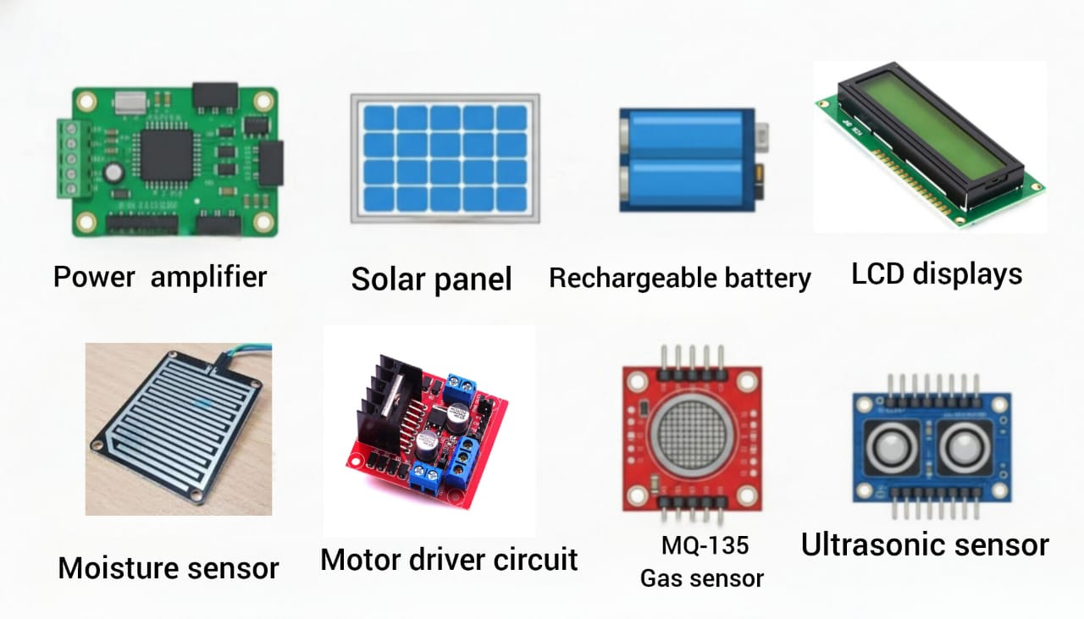
Components details
Amplifier: Strengthens weak sensor signals.
Solar Panel: Generates power for the system using sunlight.
Rechargeable Battery: Stores solar energy for continuous operation.
LCD Display: Shows system status and bin information.
Moisture Sensor: Differentiates wet and dry waste.
Object Sensor: Detects the presence of incoming waste.
Gas Sensor (MQ-135): Identifies organic or decomposing waste.
Ultrasonic Sensor: Monitors bin fill level.
Motor Driver Circuit: Operates motors for bin selection.

Slide 12
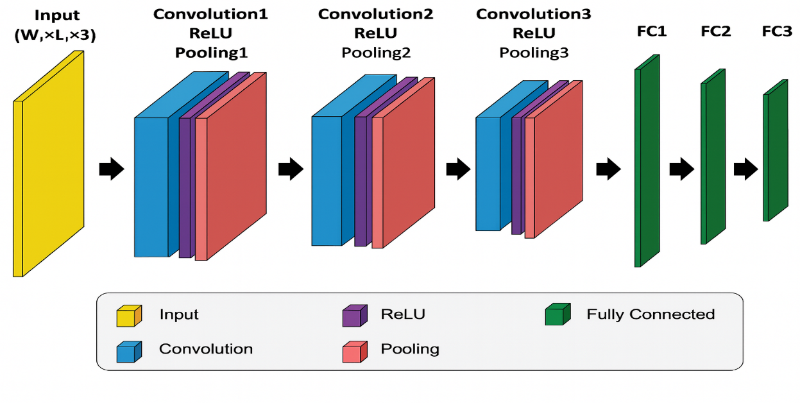
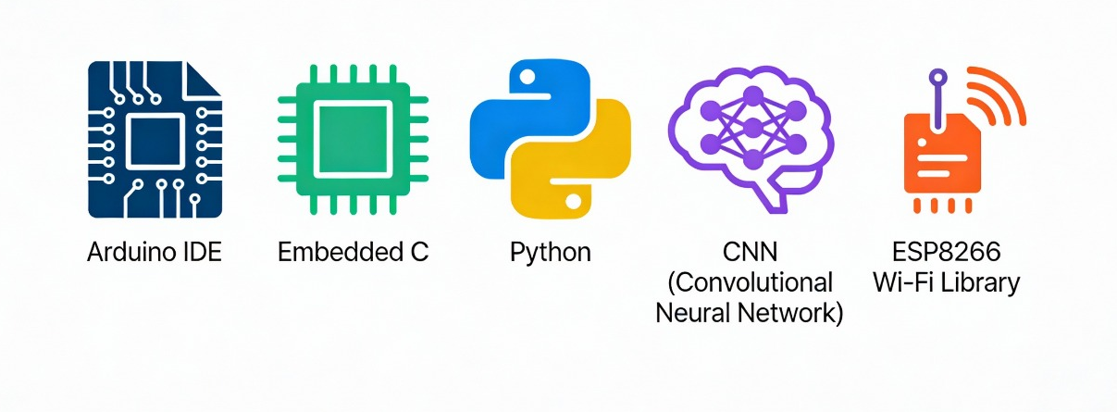
Software tools
CNN (Convolutional Neural Network)
Arduino IDE – Used to write and upload code to ESP8266 and Arduino Nano.
Embedded C – Programming language used for microcontroller control.
Python – Used to run and test the machine learning model.
CNN (Convolutional Neural Network) – Used for electronic waste classification.
ESP8266 Wi-Fi Library – Used for IoT communication and alerts.

Slide 13
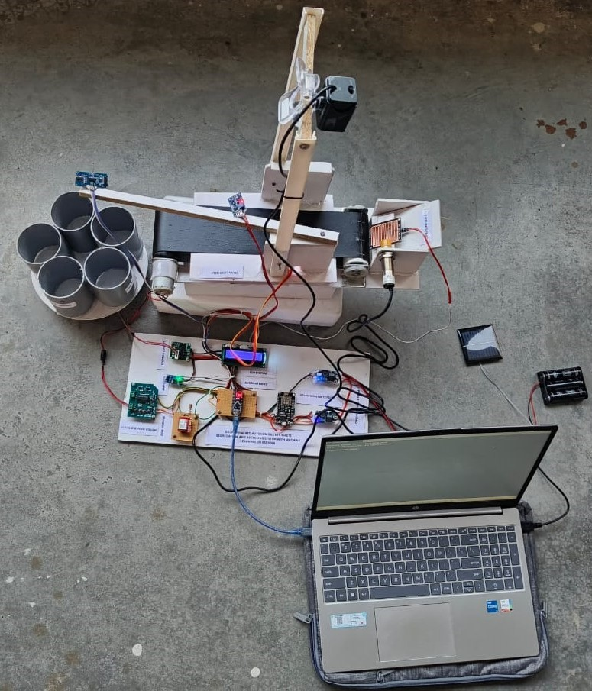
HARDWARE IMPLEMENTATION

Slide 14
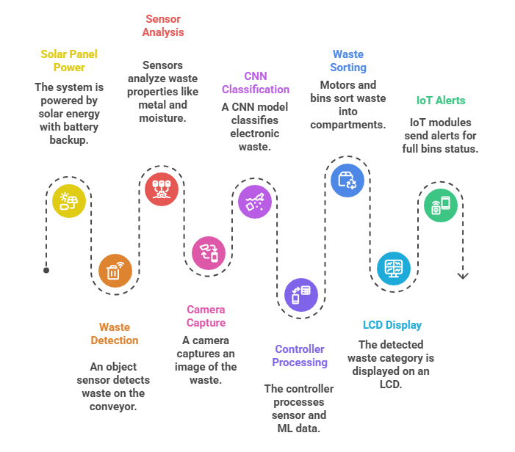
WORKING PRINCIPLE
The system is powered by a solar panel with battery backup.
Waste placed on the conveyor is detected by an object sensor.
Sensors (metal, moisture, gas, ultrasonic) analyze
the waste properties.
A camera captures the image of waste for electronic waste detection.
A CNN machine learning model classifies electronic waste accurately.
The controller processes sensor and ML data to decide the waste type.
Motor and rotating bins direct waste into the correct compartment.
LCD displays the detected waste category.
IoT modules send alerts when bins are full or need maintenance.

Slide 15
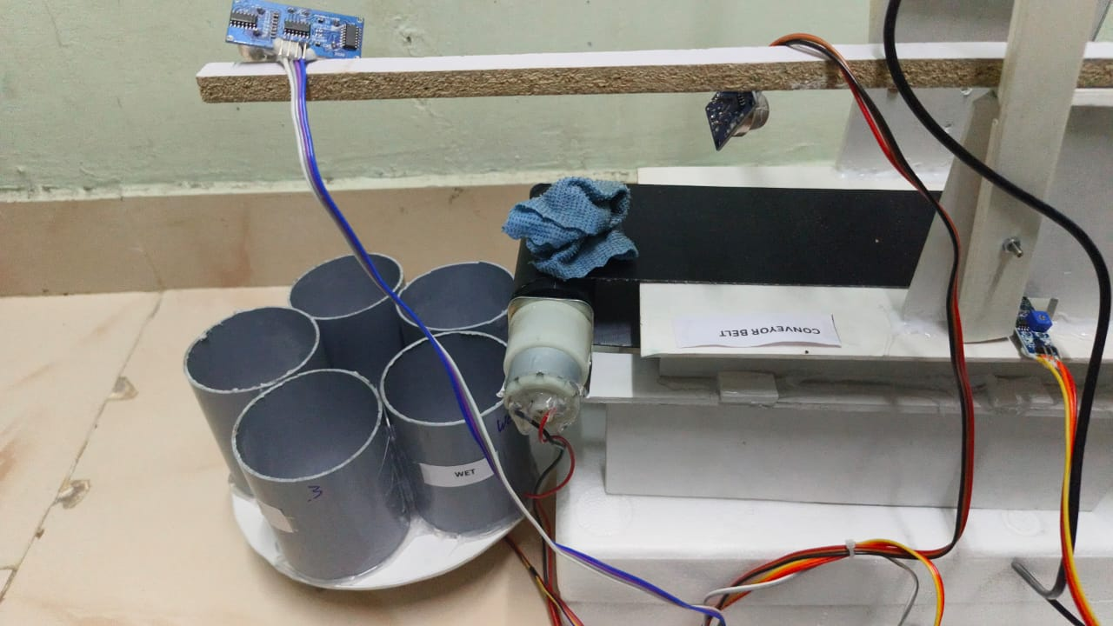
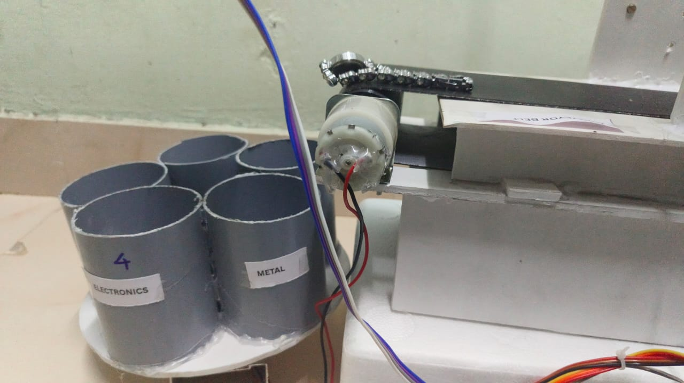
OUTPUTS
Fig 1: shows how wet waste is separated.
Fig 2: The waste that was separated as metal waste

Slide 16
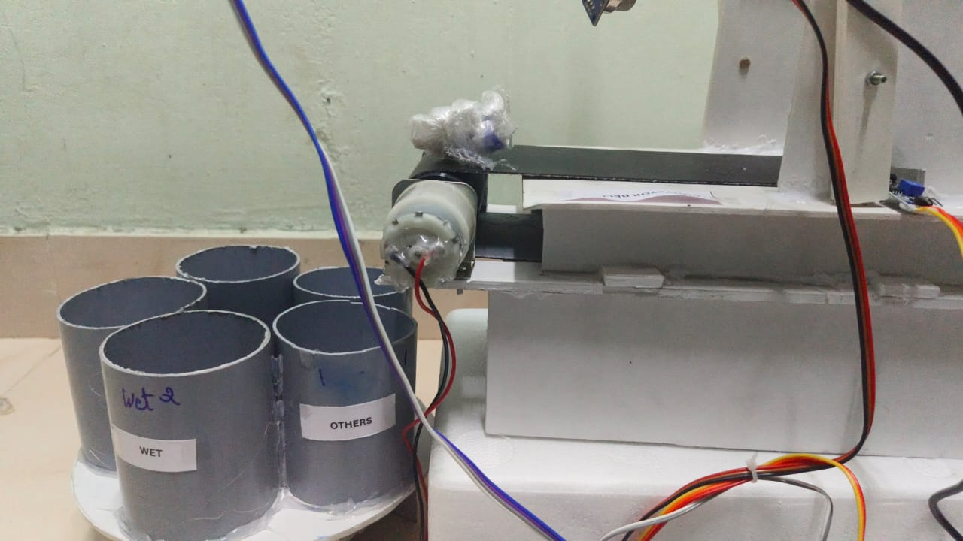
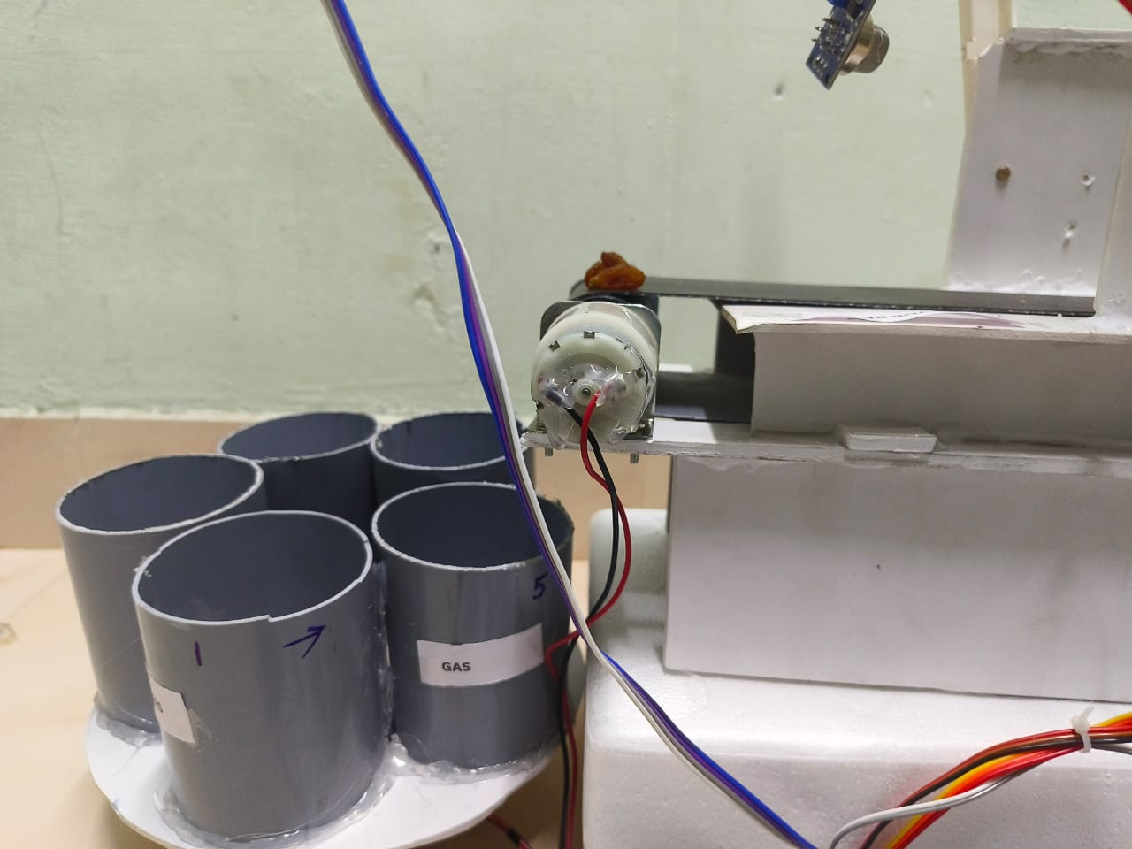
OUTPUTS
Fig 3: The waste segregated as others
because the waste cannot be identified
Fig 4: demonstrates the classification of waste as
gaseous material.

Slide 17
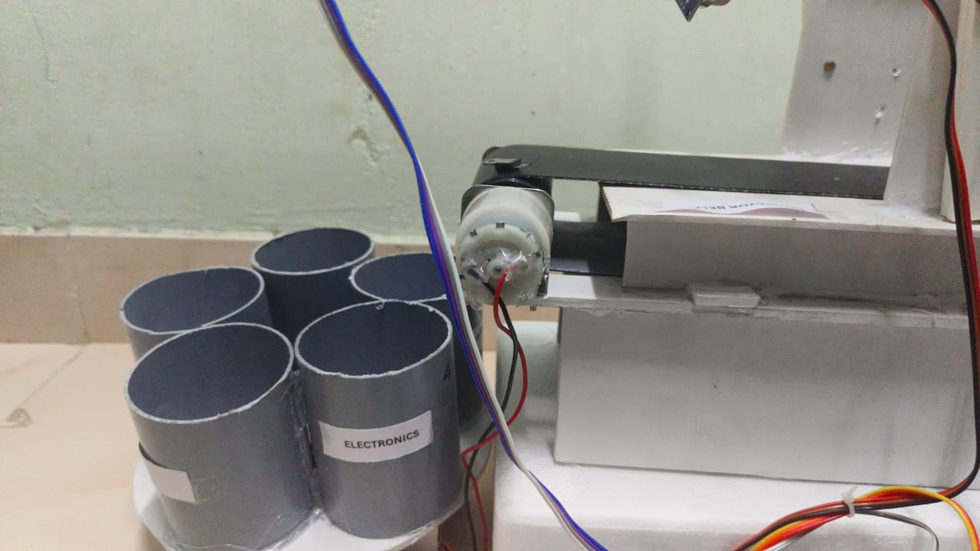
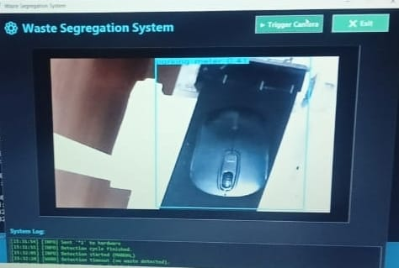
OUTPUTS
Fig 5: Electronic waste is segregation
Fig 6: The waste in the figure is input of CNN to classify the electronic waste

Slide 18
CONCLUSIONS
The system provides an automated and efficient solution for waste segregation by combining sensors, machine learning, and IoT technology. It is powered entirely by solar energy, making it eco-friendly and suitable for sustainable operation in remote or low-power areas. The ESP8266 microcontroller enables real-time monitoring, data collection, and connectivity for smart decision-making. By reducing human intervention and manual errors, the system improves accuracy and efficiency in waste sorting and recycling. Overall, it offers a scalable, intelligent, and environmentally friendly approach to modern waste management, promoting cleaner surroundings and sustainable practices.

Slide 19
REFERENCES
Kumar, R., & Singh, P. (2022). IoT-Based Smart Waste Management System: A Review. International Journal of Advanced Research in Electrical, Electronics, and Instrumentation Engineering, 11(5), 234–242.
Sharma, A., & Verma, S. (2021). Machine Learning Techniques for Automated Waste Classification. Journal of Cleaner Production, 278, 123456.
Patel, D., & Joshi, M. (2020). Solar-Powered Smart Waste Segregation Using Microcontroller and Sensors. International Journal of Engineering Research & Technology, 9(10), 112–118.
Agarwal, V., & Kumar, S. (2021). IoT and Embedded Systems in Smart Waste Management Applications. International Journal of Internet of Things and Embedded Systems, 3(2), 45–53.
G.Ginting, R. D. Apnena, “Smart Waste Management and Recycling Based on IoT Using Machine Learning Algorithm,” Journal of Applied Intelligent Systems, vol. 9, no. 2, 2024.

Slide 20
OUTCOME

